Slide 1

Machine Learning project 2
This presentation details the data exploration, feature engineering, modeling, and evaluation phases for our machine learning project focused on fraud detection.

Slide 2
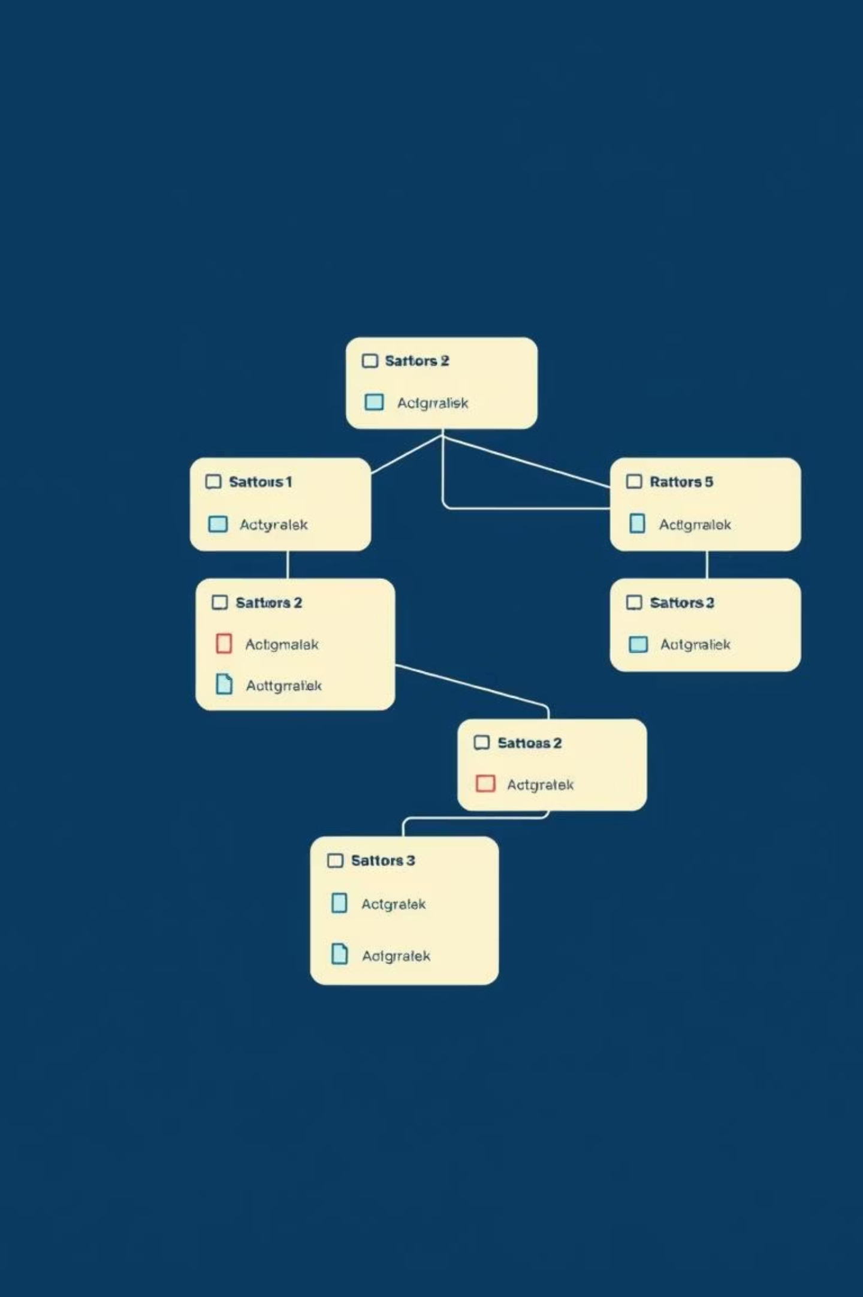
Dataset Overview
1
Train_Beneficiarydata.csv
Patient demographics, coverage months, and chronic conditions.
2
Train_Inpatientdata.csv
Hospital admission claims and financial information.
3
Train_Outpatientdata.csv
Outpatient visit and procedure records.
4
Train_labels.csv
Provider-level fraud labels (Fraud / Not Fraud).
Datasets were merged using BeneID (patient claims) and Provider (fraud labels) for supervised learning.

Slide 3

Data Cleaning & Missing Values
Missing Values Handled
Cleaning Steps
Death dates (expected for living patients)
Removal of illegal/malformed values
Consistent datetime format conversion
Chronic disease indicators
Normalization of categorical encodings
Financial fields in claims
Validation of numeric ranges
Approaches Implemented
These steps ensured no data loss and prevented artificial signal introduction, preparing a robust dataset.
Meaningful defaults for medical data
Zero replacement for missing financial values
Explicit handling of beneficiary records with missing coverage months

Slide 4
Exploratory Data Analysis & Feature Engineering
Our initial exploration revealed critical insights into the dataset, guiding our feature engineering process to prepare the data for robust fraud detection models.
Exploratory Analysis
Feature Engineering
Verified fraud class imbalance, highlighting the need for specialized handling.
Performed provider-level aggregation to create summary statistics.
Inspected provider behavior patterns, identifying common characteristics of fraudulent activities.
Created key financial statistics: mean, max, and sum of reimbursements per provider.
Identified extreme financial values, pinpointing potential outliers and data entry issues.
Generated behavioral indicators such as claims per provider, unique beneficiaries served, and average stay duration.
Analyzed claim frequencies and patient loads per provider, understanding operational scales.
Outcome: Raw claims were transformed into machine-learning-ready features, resulting in over 60 meaningful provider metrics.
Example: Provider-Level Aggregation
provider_df = df.groupby("Provider").agg({ "ClaimID": "count", "BeneID": "nunique", "InscClaimAmtReimbursed": ["sum", "mean", "max"], "HospitalDays": "mean"}).reset_index()

Slide 5
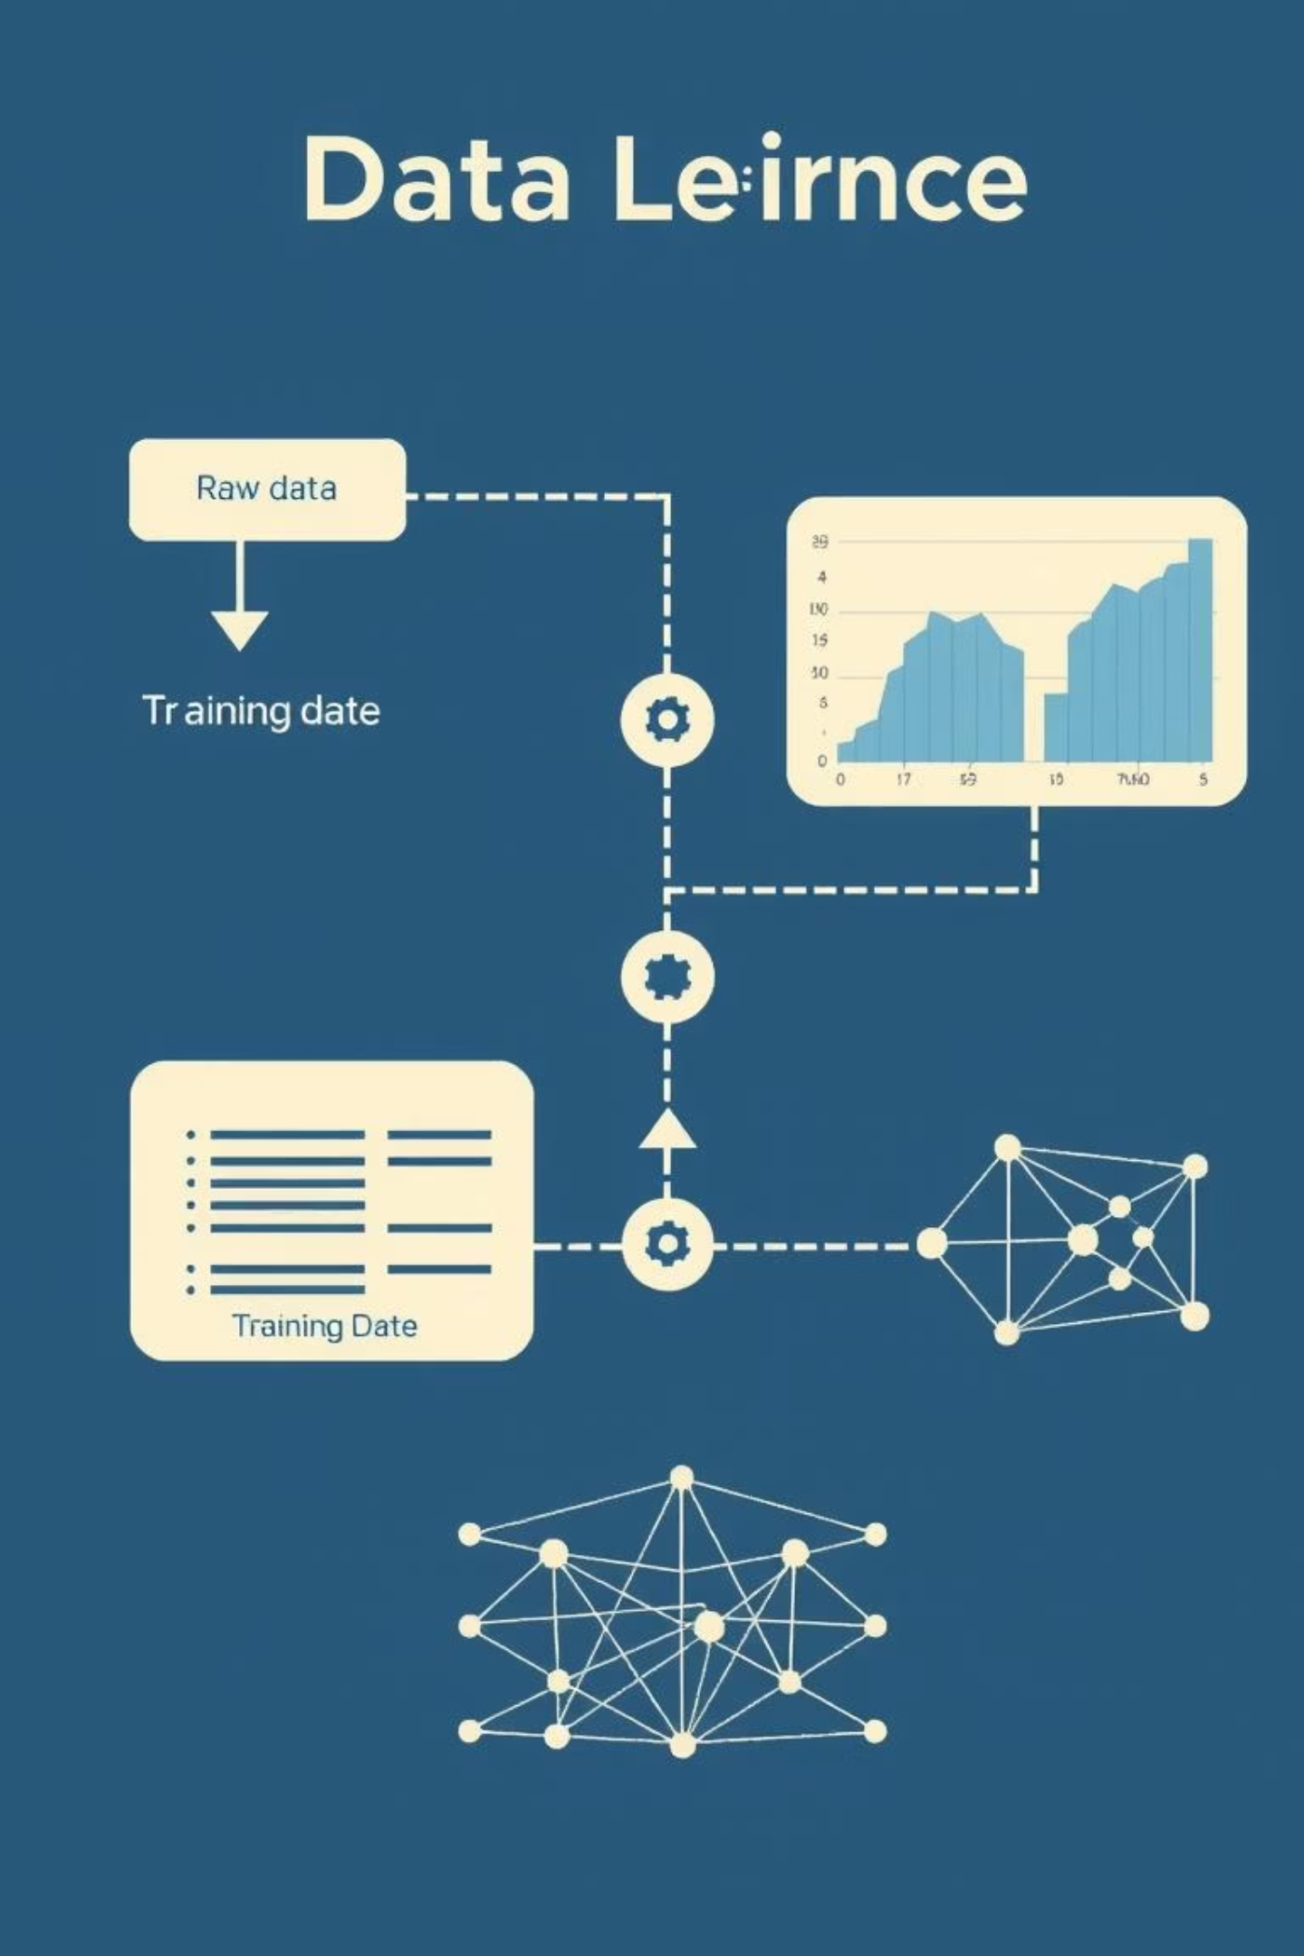
Modeling Pipeline (Training Setup)
01
Provider-Level Dataset
Each row represents a unique provider, incorporating over 60 carefully engineered features for comprehensive analysis.
02
Clear Training Pipeline
The feature matrix (X) and fraud label (y) are distinctly separated, establishing a clean input for model training.
03
Proper Data Splitting
Data is split 70% for training and 30% for testing, with stratification to precisely preserve the original fraud ratio.
04
Imbalance-Aware Modeling
Specific strategies are employed to carefully manage rare fraud events, ensuring robust model performance on skewed data.
The following Python snippet illustrates the data splitting process:
X = df.drop("Fraud", axis=1)y = df["Fraud"]X_train, X_test, y_train, y_test = train_test_split( X, y, test_size=0.3, stratify=y, random_state=42)

Slide 6

Aggregation & Feature Engineering
Claim Counts
Reimbursement
Length of Stay
Summarized per provider.
Mean, sum, max amounts.
Average duration.
Diagnoses & Procedures
Beneficiary Metrics
Frequency and diversity.
Count and cost per beneficiary.
Over 60 derived features were created, including patient risk profiles and severity patterns, transforming raw transactions into stable behavioral profiles.

Slide 7

Modeling Dataset & Visualizations
Final Dataset Structure
Visualizations Produced
One row per provider
Excludes identifiers from training
Fraud class imbalance
Includes engineered numeric features, fraud label, and metadata
Provider claim volume distribution
Reimbursement distributions
Exploratory Plots Confirmed
Correlation heatmaps
This stage transformed raw data into a structured intelligence view, producing a predictive, explainable, and business-relevant dataset.
Strong class imbalance (~10% fraud)
Financial skewness and non-linear distributions

Slide 8

Imbalance Handling & Model Training
Healthcare fraud instances are inherently rare, comprising approximately 10% of our dataset. This significant class imbalance can lead standard machine learning models to bias predictions towards the more prevalent non-fraudulent class, compromising detection accuracy.
Addressing Imbalance
To counter the model's natural bias towards the majority class, we implemented class weighting. This technique assigns higher importance to the minority (fraudulent) class during model training, ensuring its patterns are adequately learned.
Models Compared
A suite of diverse machine learning algorithms was employed to identify the most effective fraud detection strategy:
Logistic Regression
Random Forest
Gradient Boosting
Support Vector Machine (SVM)
The following Python snippet illustrates how these models were prepared for training:
models = { "Logistic Regression": LogisticRegression(class_weight="balanced"), "Random Forest": RandomForestClassifier(), "Gradient Boosting": GradientBoostingClassifier(), "SVM": SVC(probability=True)}for name, model in models.items(): model.fit(X_train, y_train)

Slide 9

Modeling Phase: Fraud Detection
With our robust, engineered dataset, the focus shifts to building and training the fraud detection model. This phase involves selecting appropriate algorithms and refining the dataset for optimal performance.
Claim Volume
Total number of claims processed per provider, indicating activity levels.
Unique Beneficiaries
Count of distinct patients associated with each provider, highlighting reach.
Total Reimbursement
Sum of all claim amounts reimbursed to a provider, flagging financial scale.
Average Reimbursement
Mean reimbursement value per claim, revealing potential cost inflation patterns.
These provider-level aggregations serve as crucial features for identifying suspicious patterns and detecting fraudulent activities.

Slide 10

Modeling Phase: Fraud Detection
Our goal is to train ML models to identify potentially fraudulent healthcare providers, addressing the highly imbalanced nature of fraud detection (fraud ≈ 10%).
Train–Test Splitting
70/30 split at the provider level to prevent data leakage and ensure reproducibility with a fixed random seed.
Handling Class Imbalance
Three strategies: Class Weighting (penalizing fraud misclassifications), and Oversampling (SMOTE) to generate synthetic fraud samples.

Slide 11
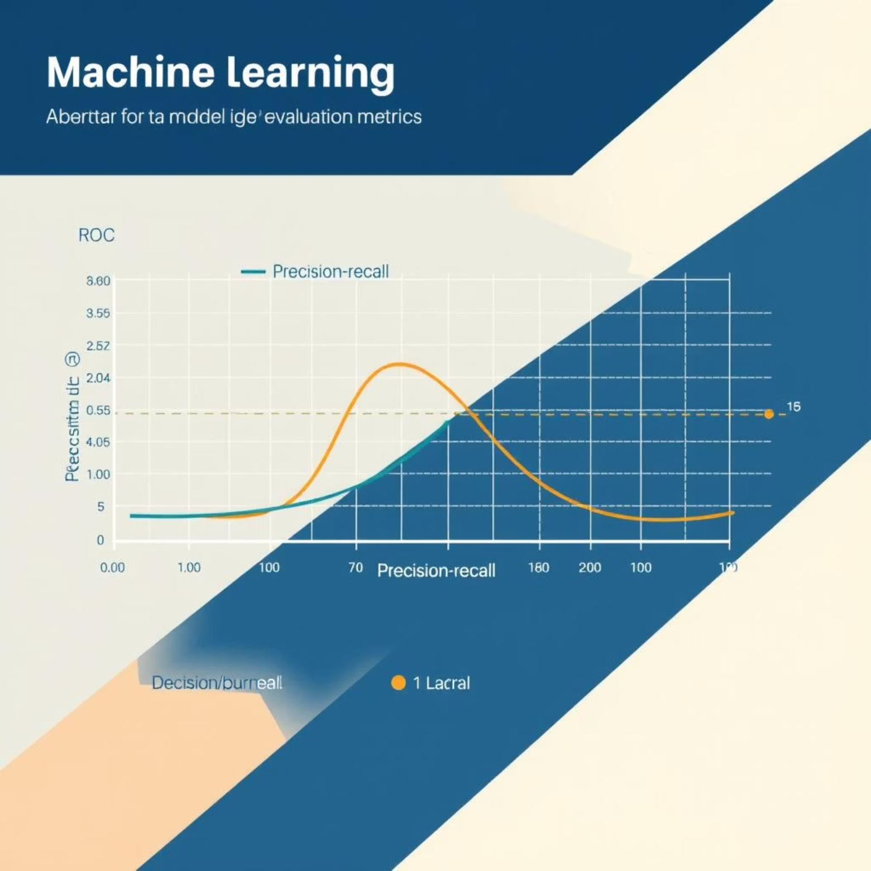
Evaluation & Final Model Selection
Why Accuracy is Misleading
For imbalanced datasets like fraud detection (fraud ≈ 10%), overall accuracy can be deceptive. A model predicting no fraud would still be 90% 'accurate' without detecting any actual fraud.
Key Evaluation Metrics
Correct evaluation prioritizes metrics that effectively measure performance on the minority class:
ROC-AUC: Assesses model's ability to distinguish between classes.
Recall: Measures the proportion of actual fraud cases correctly identified.
Precision: Indicates the proportion of positive identifications that were actually correct.
Final Model Choice: Logistic Regression
After rigorous evaluation, Logistic Regression achieved the best ROC-AUC and demonstrated the most stable performance with explainable coefficients, crucial for understanding fraud patterns.
The following Python snippet illustrates key evaluation steps:
y_prob = model.predict_proba(X_test)[:,1]roc_auc = roc_auc_score(y_test, y_prob)y_pred = model.predict(X_test)confusion_matrix(y_test, y_pred)

Slide 12

Metric Selection & Algorithms
Primary Metrics (Accuracy Avoided)
Algorithms Implemented
Precision
Logistic Regression: Baseline & interpretability
Recall
F1-score
Random Forest: Robust ensemble
PR-AUC
ROC-AUC
Gradient Boosting: High precision learning
Support Vector Machine: Margin-based classification

Slide 13

Hyperparameter Tuning & Interpretation
Hyperparameter Tuning
Model Interpretation
Each model was calibrated using grid search or reasonable defaults:
Tree-based models provided natural interpretability through:
Logistic: Regularization tuning
Feature importance ranking
Random Forest: Estimators, max depth
Cost drivers influencing fraud probability
Gradient Boosting: Learning rate, estimators
Final Model Selection
Feature Scaling
Logistic Regression achieved the best overall performance (highest ROC-AUC) due to its strong discrimination and stability.
Normalization/standardization applied for Logistic Regression and SVM; excluded for tree-based models.

Slide 14
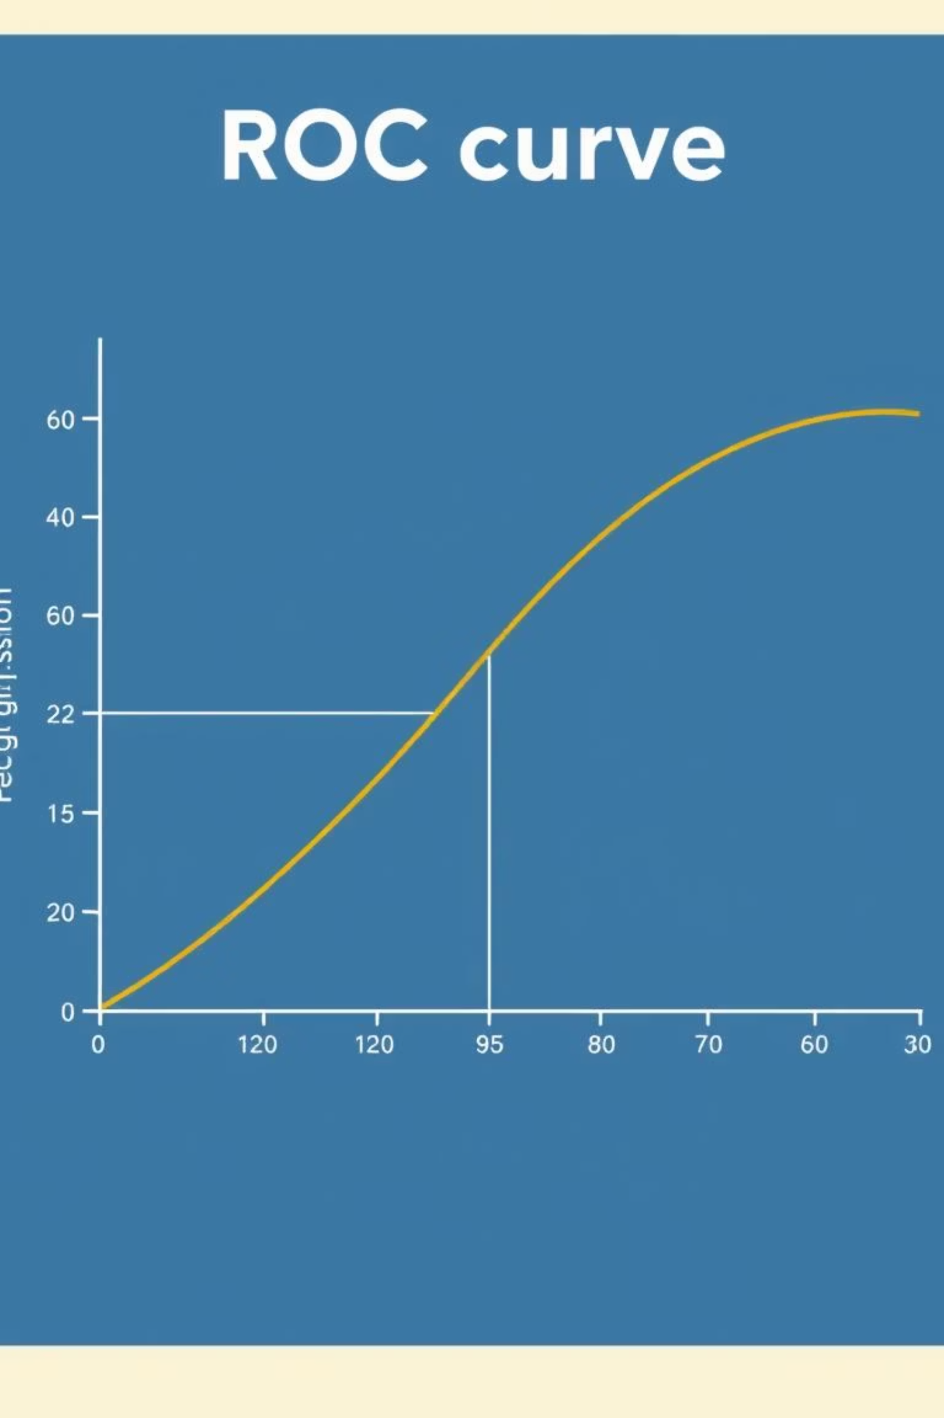
Evaluation Phase: Model Quality & Reliability
Evaluation emphasizes fraud detection capability, cost-sensitive decision-making, and model explainability due to class imbalance.
Metrics Used
1
ROC-AUC (primary), PR-AUC, Precision, Recall, F1-score, Confusion Matrix.
2
Results: Logistic Regression
Highest ROC-AUC, outperforming complex models, indicating linear behavior patterns dominate fraud separation.
Confusion Matrix Insights
3
False positives among high-cost specialists; false negatives for low-volume, stealth fraud.

Slide 15
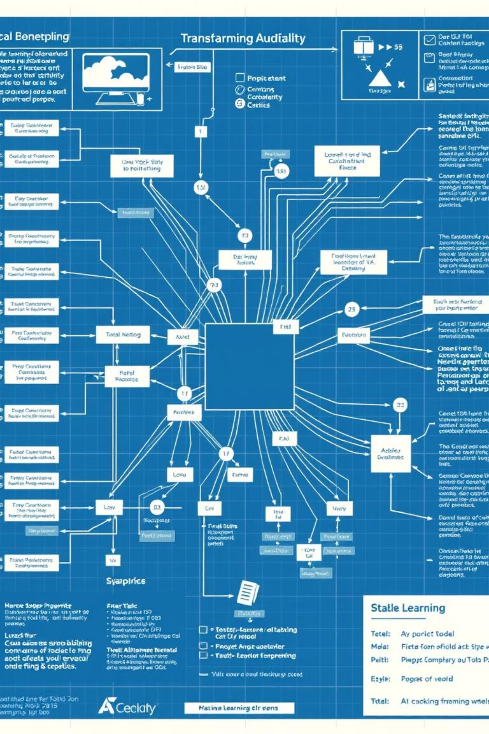
Model Stability & Interpretability
Logistic Regression was chosen for its robust characteristics that are critical in a fraud detection context.
No Overfitting
Stable Trade-offs
The model demonstrated strong generalization capabilities on unseen data, preventing false confidence in performance.
Consistent precision-recall behavior across different thresholds ensures predictable operational outcomes.
Clear Coefficient Behavior
Transparent feature contributions enable straightforward understanding of why a specific provider is flagged.
Impact of Model Choice
These characteristics collectively support both legal accountability and auditable decisions, crucial for regulatory compliance and dispute resolution in healthcare fraud.

Slide 16

Error Analysis & Conclusion
False Positives
Logistic Regression Demonstrated
Causes: Rare medical procedures, high-risk patients.
No overfitting
Interpretation: Legally expensive, not fraudulent.
Stable precision-recall trade-offs
Clear coefficient behavior
False Negatives
Our Conclusion
Causes: Fraud camouflage, conservative billing, low-volume manipulation.
The final system reliably identifies suspicious providers, balancing detection, fairness, interpretability, and cost.
Interpretation: Cases evade statistical detection.

